Slide 1

BC2410, Prescriptive Analytics From Data to Decisions
Lecture 2

Slide 2
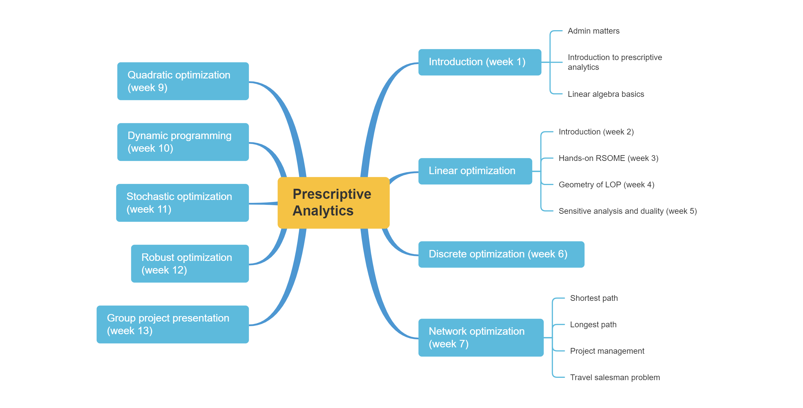
Schedule

Slide 3
Schedule

Slide 4
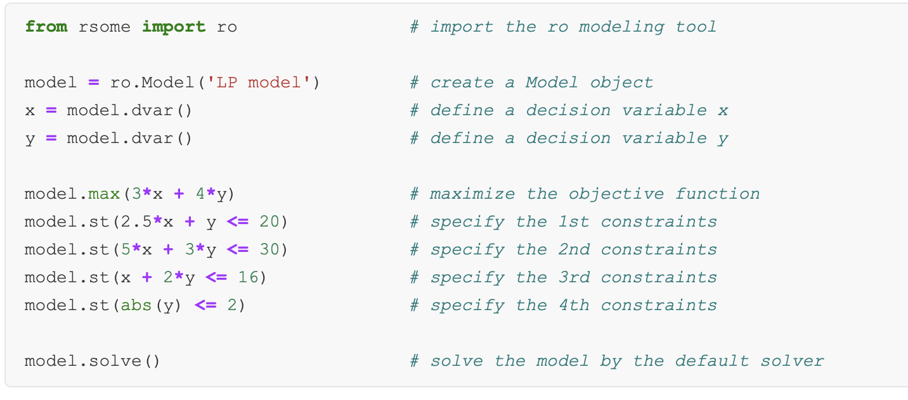
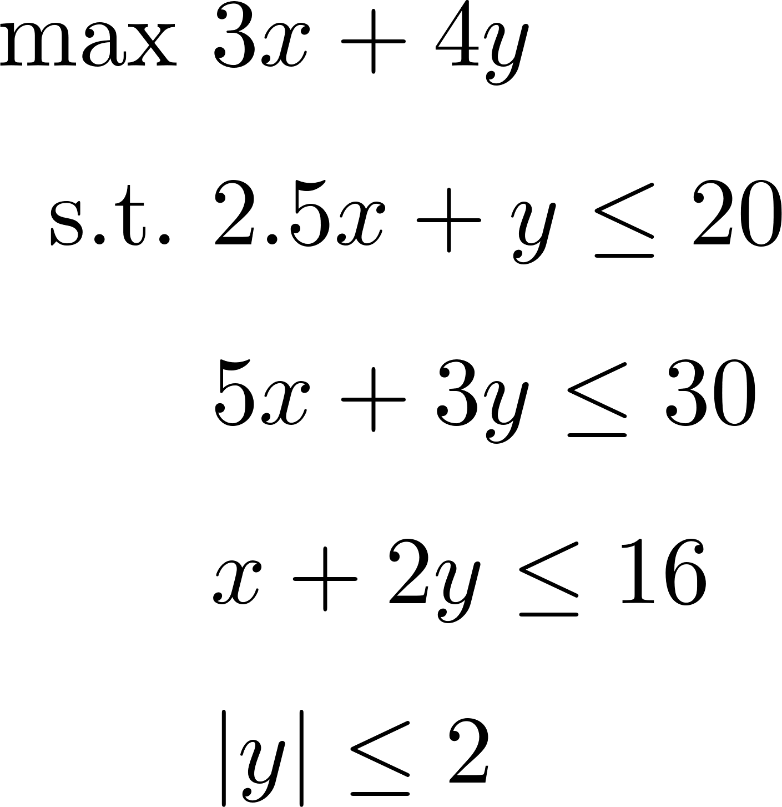
A Linear Programming Example

Slide 5
LOP Tricks
Linearizing objective

Slide 6
LOP Tricks
Linearizing objective
Notes:
The lower z you can get is f(x), so both are exactly the same
What if max f(x)?
max z
s.t. z <= f(x)

Slide 7
LOP Tricks
Minimax objective
Notes:
How about max min?

Slide 8
LOP Tricks
Notes:
Is this a linear optimization model
Can you convert it to a linear optimization model

Slide 9
LOP Tricks
Minimax objective

Slide 10
LOP Tricks
Absolute values

Slide 11
LOP Tricks
Notes:
|xj| = max{xj, -xj}

Slide 12
LOP Tricks
Notes:
When c <= 0, we cannot reformulate it to a LOP. Why?
-max{a,b} = min{-a,-b}

Slide 13
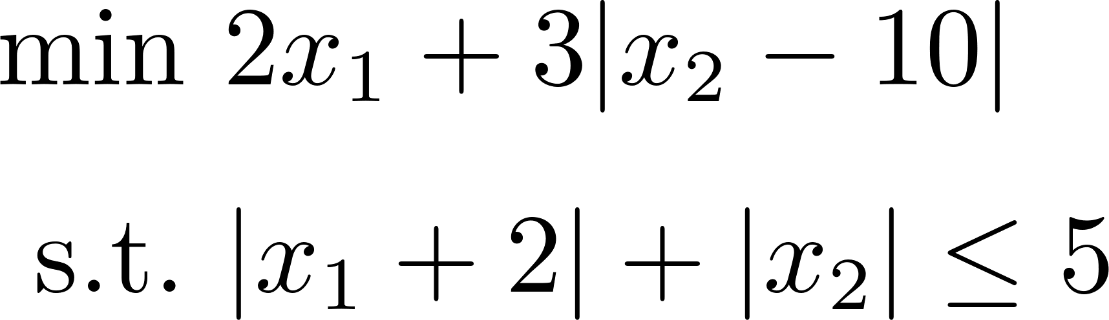
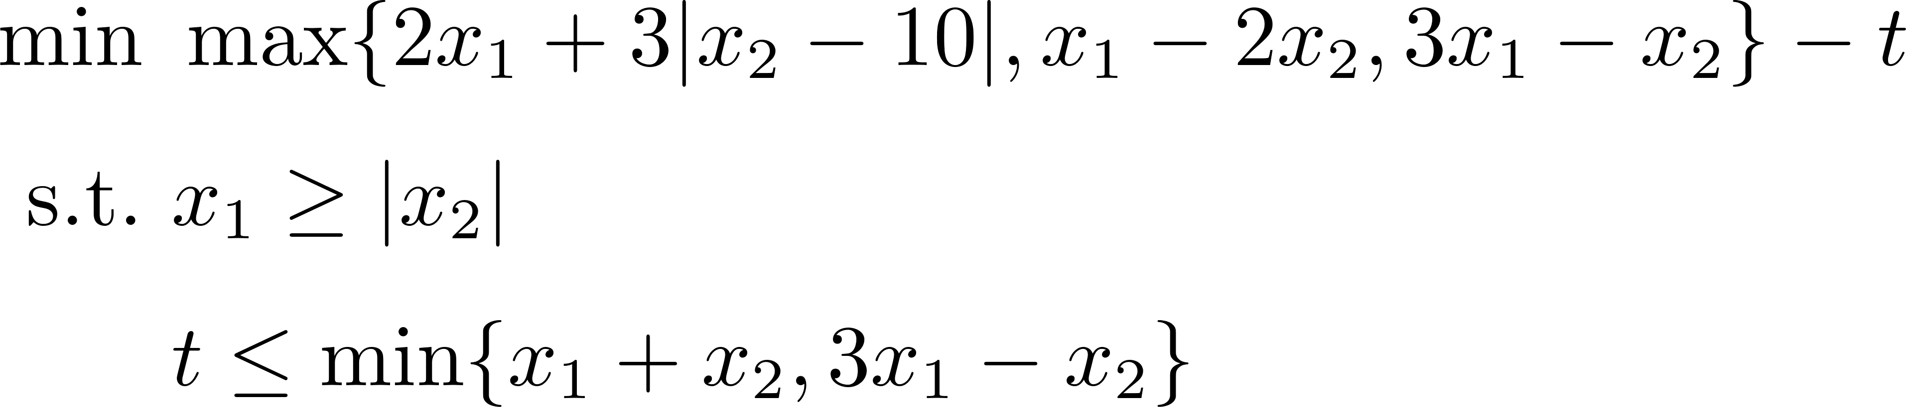
Exercises
Notes:
Min 2*x1 + 3*y1
s.t. y2 + y3 <= 5
y1 >= x2 – 10
y1 >= -x2 + 10
y2 >= x1 + 2
y2 >= - x1 – 2
y3 >= x2
y3 >= -x2
Min z – t
s.t. z >= 2x1 + 3y1 z >= x1 – 2x2
z >= 3x1 – x2
y1 >= x2 – 10
y1 >= -x2 + 10
x1 >= x2
x1 >= -x2
t <= x1 + x2
t <= 3x1 – x2

